Slide 1



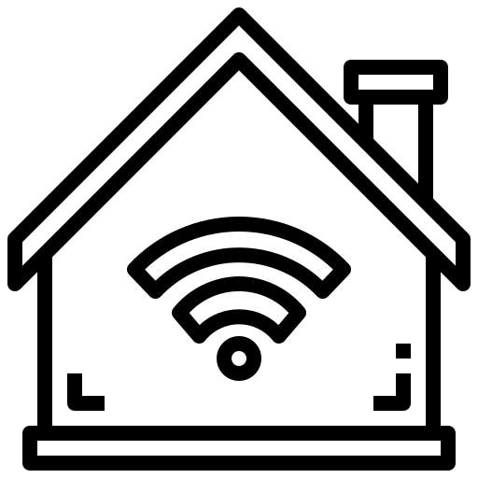
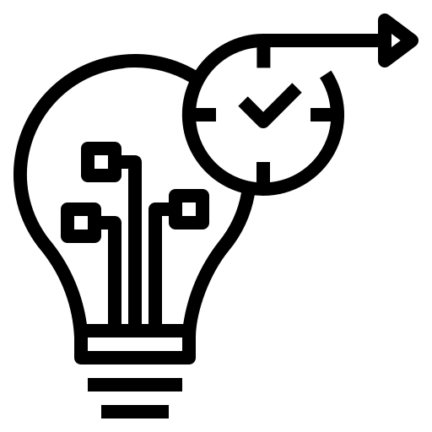
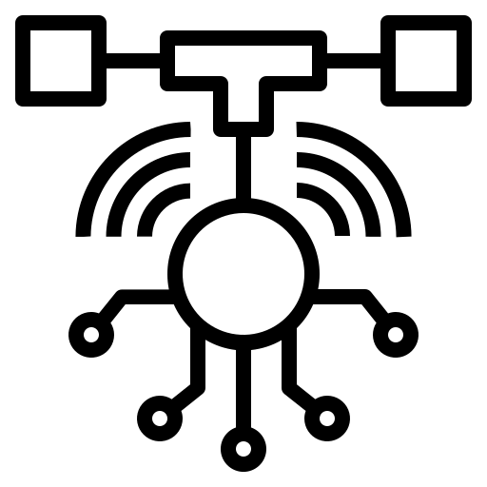
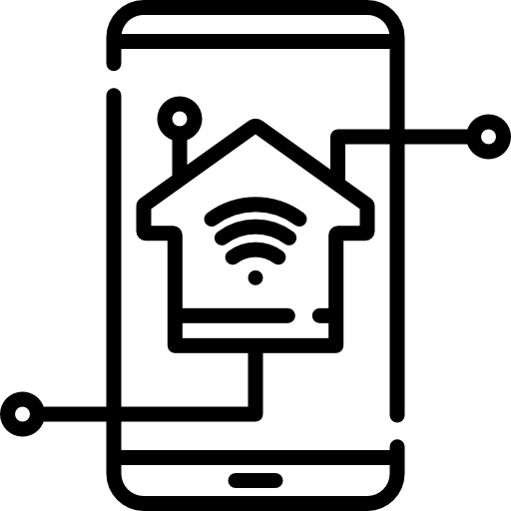
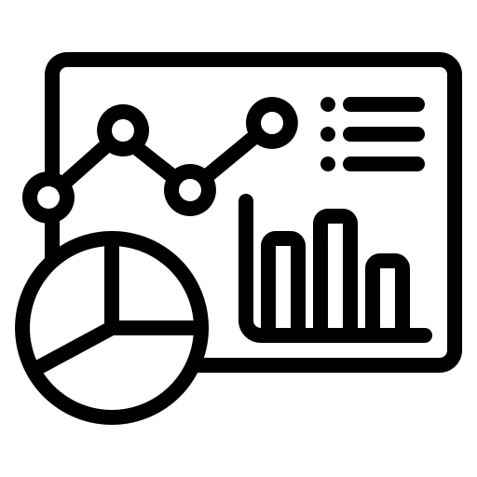
Internet Of Things PPT
Security and Privacy
Addressing security challenges and implementing measures to protect IoT systems and user data.
Sensor Technology
Exploring various sensors used to collect data in IoT systems.
Applications of IoT
Exploring real-world applications across various industries, including smart cities, healthcare, agriculture
IoT Architecture
Exploring the layers and components of an IoT system, including devices.
Future Trends
Discussing emerging technologies and trends shaping the future of IoT, such as edge computing.
Connectivity Protocols
Understanding communication protocols such as Wi-Fi, Bluetooth, and MQTT.
Smart Home Automation
Integrating IoT devices to automate home tasks such as lighting, temperature control, and security.
Data Analytics
Analyzing and interpreting the large volumes of data generated by IoT devices.

